Slide 1
Text search
Team 1
Name | B. N
Abanoub Samy | 1
Abanoub Adel | 2
Seif Eldin Elsayed | 12
Nesreen Ahmed | 25
Nour Abdelsater | 26

Slide 2

Download the project
Full Project:
You can download the entire project from this URL:
https://github.com/Abanoub-Adel-Gerges/Text-SearchSource
Code Only:
If you only need the source code (for use in IDEs other than IntelliJ), use this link:
https://github.com/Abanoub-Adel-Gerges/Text-Search/tree/main/Text%20Search/src

Slide 3
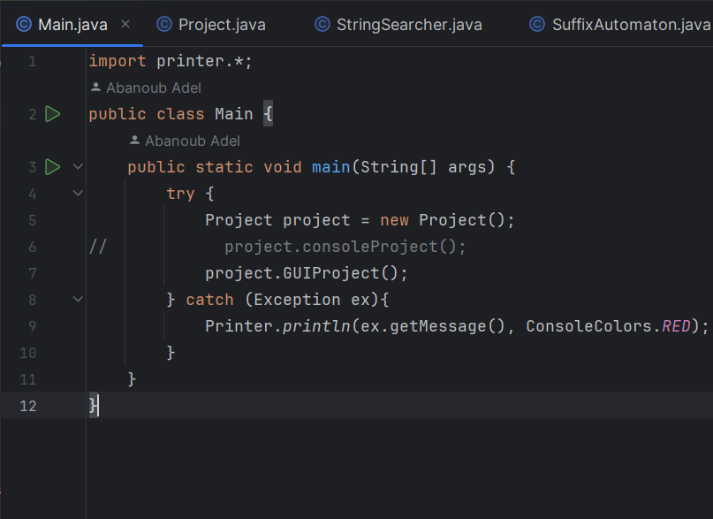
How to run
1- Open the Main function in your IDE.
2- Click Run to start the GUI version.
3- To switch to Console mode:
- Uncomment
project.consoleProject();
- Comment
//project.GUIProject();
4- Currently, we are using the GUI version.

Slide 4
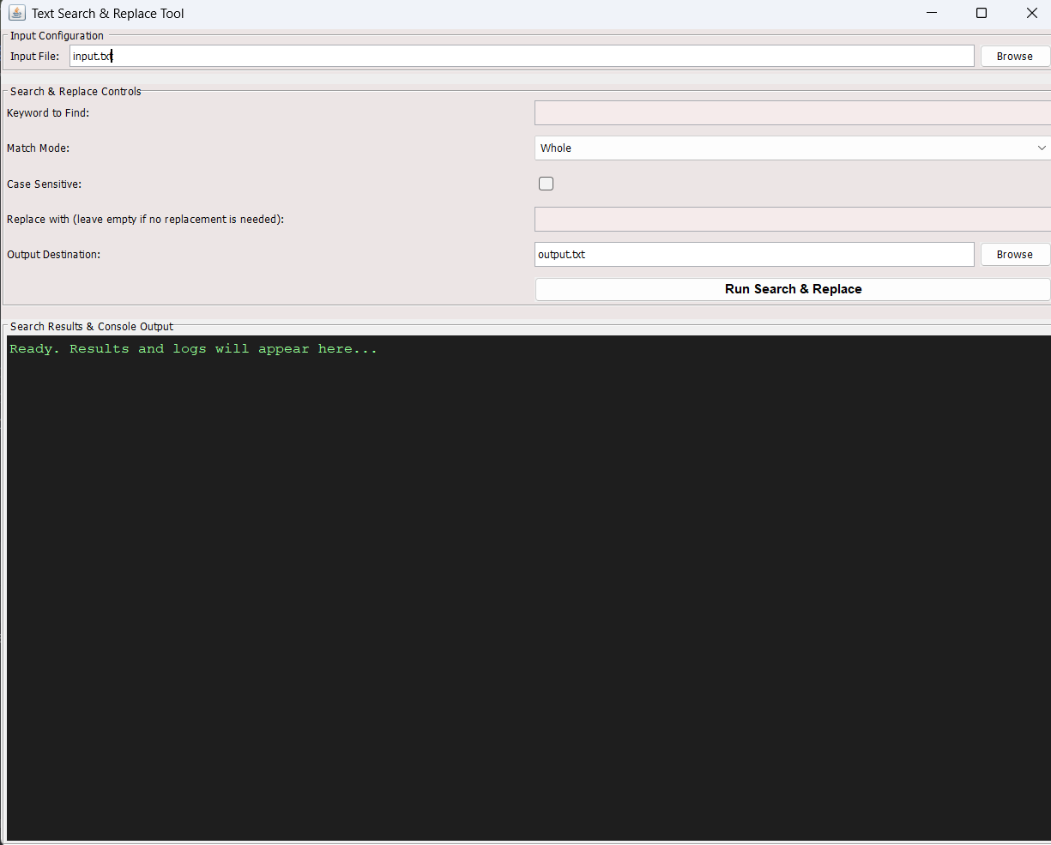
How to Use gui
By default:
Input file: input.txt
Output file: output.txt
The program creates them automatically if they don’t exist.
To use a different file: click Browse and select your file.
Add input as described for each message.
If no replacement is needed, leave the “Replace with” input field empty.

Slide 5
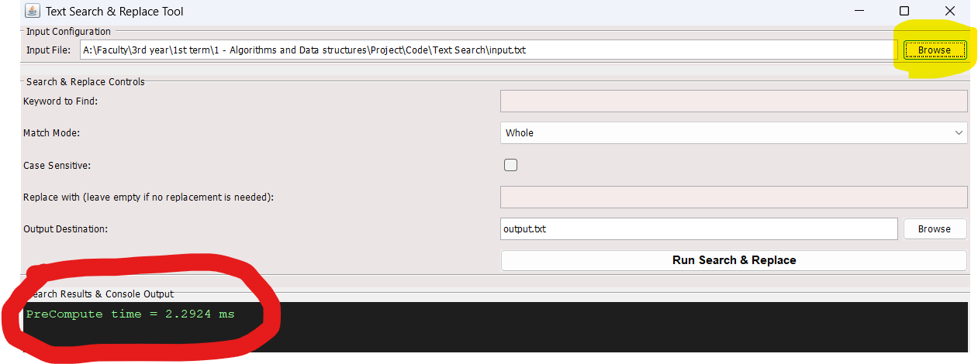
How to Use gui
Using the Browse Button
Select an input file using Browse
The program precomputes the file content
Precompute time is displayed (see image)
Once precomputed, you can apply queries as needed

Slide 6
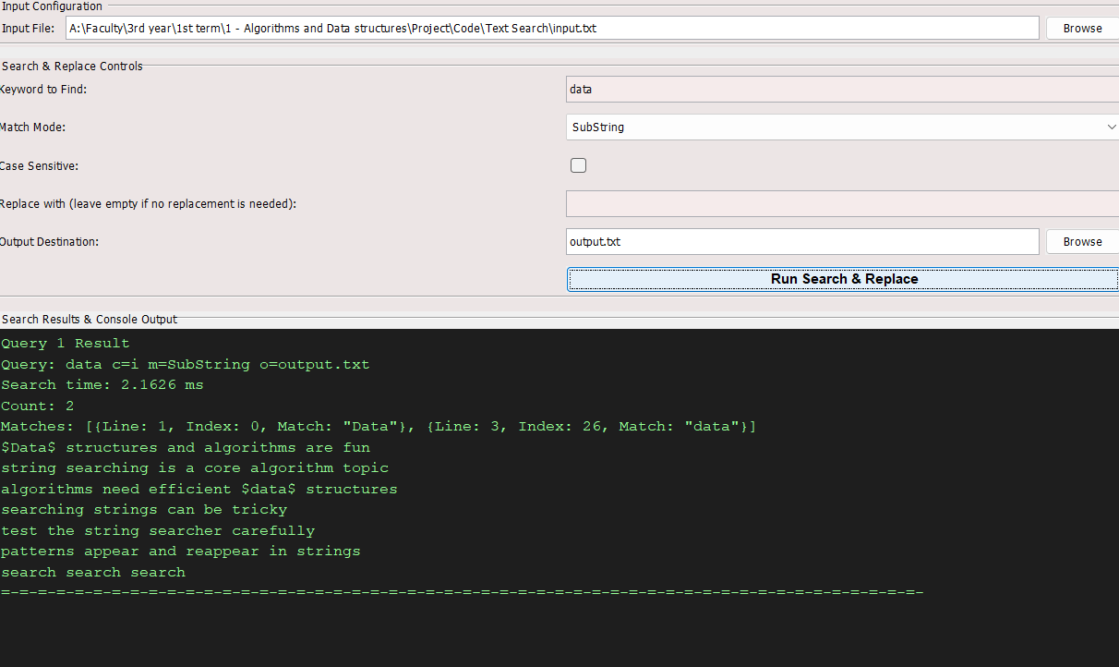
How to Use gui
Example Query Output:
As you can see in the output:
1- Query Number
2- Query input
3- Search Time
4- Matches and their count
5- Replace time (if a replacement occurs)
6- Original text with $$ marking matches

Slide 7
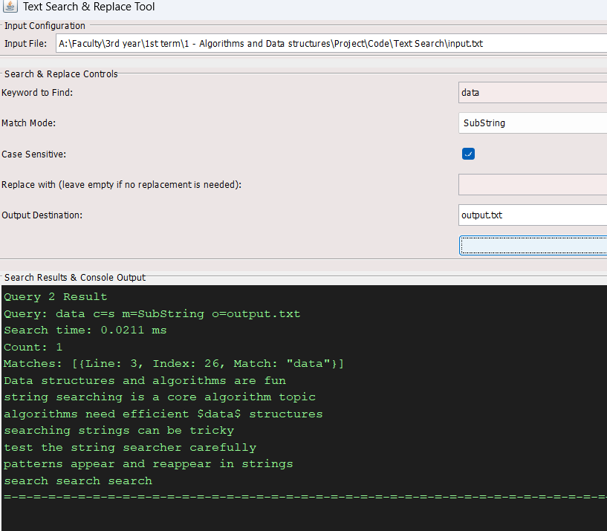
How to Use gui
Example Query Output:
As you can see in the output:
1- Query Number
2- Query input
3- Search Time
4- Matches and their count
5- Replace time (if a replacement occurs)
6- Original text with $$ marking matches

Slide 8
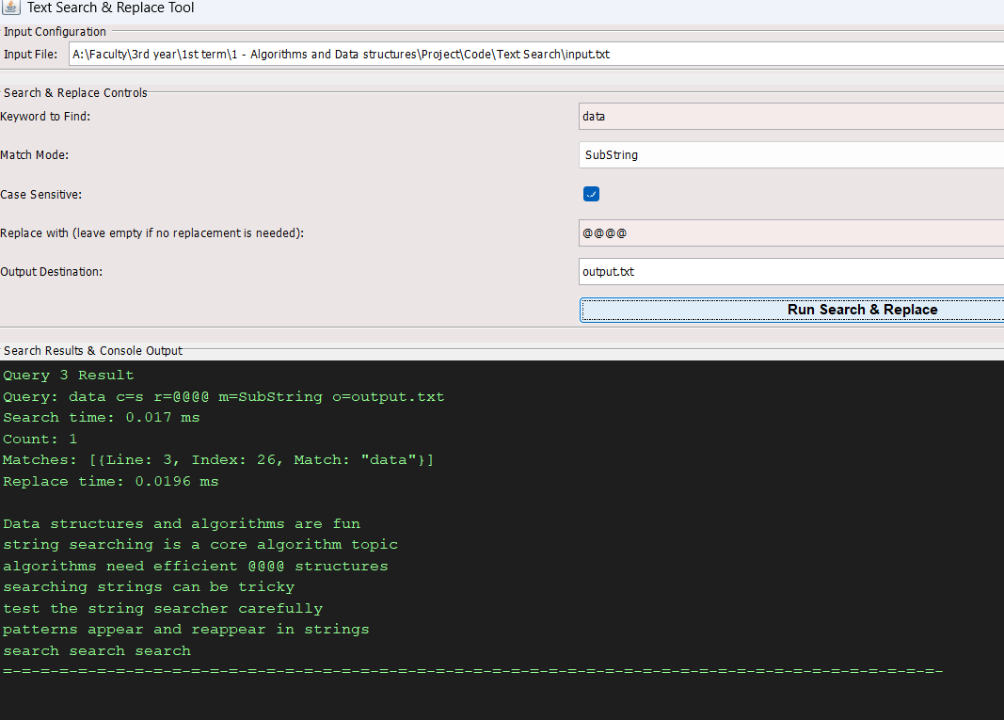
How to Use gui
Example Query Output:
As you can see in the output:
1- Query Number
2- Query input
3- Search Time
4- Matches and their count
5- Replace time (if a replacement occurs)
6- Original text with $$ marking matches

Slide 9
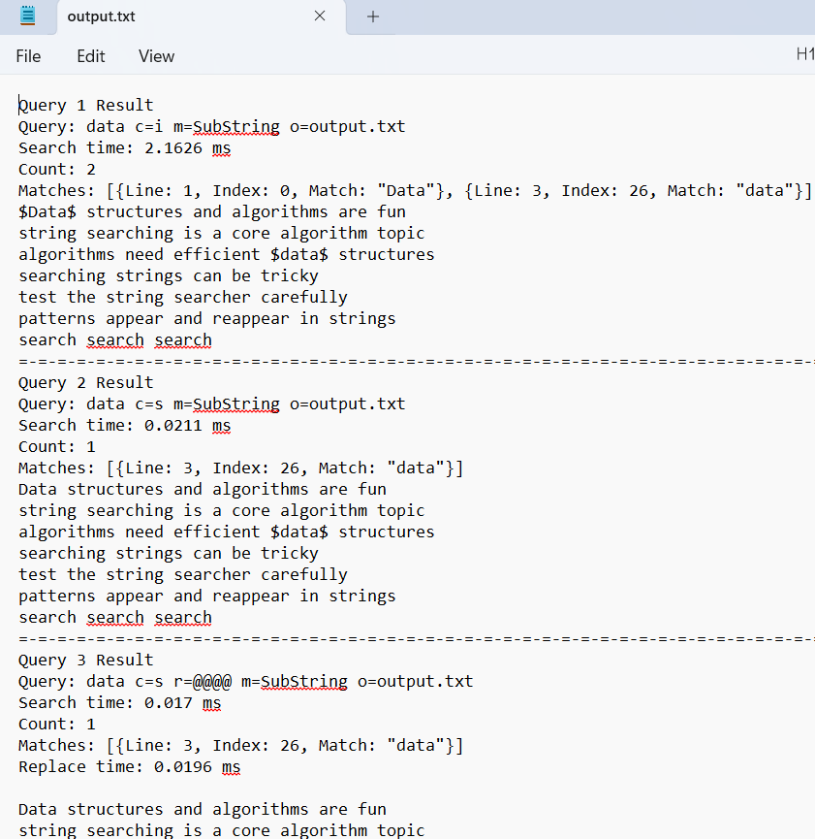
How to Use gui
After finishing queries, the selected output file (output.txt or your chosen file) is updated
The file contains all query results displayed on the screen
Example: output.txt has 3 query results in my case
Note: Selecting a new input file via Browse then applying new query clears the output file and resets query numbering to 1

Slide 10
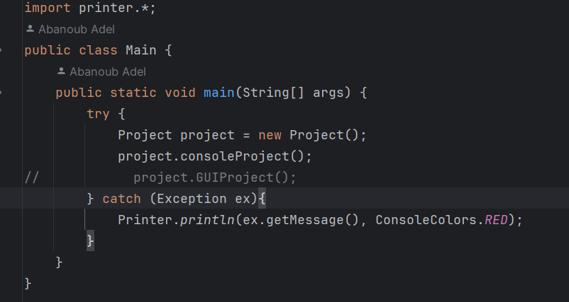
How to Use console project
Using the Console Project
- Change the function used from the project object (see image)
- Run the project again

Slide 11
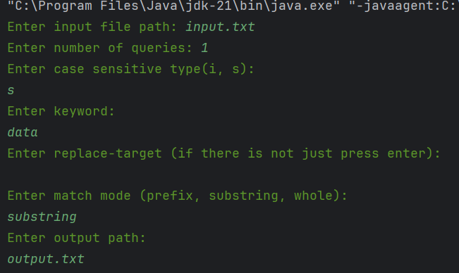
How to Use console project
1- Enter the input file path
2- Enter the number of queries
3- Enter each query one by one
4- For each query, provide input as described in the instructions (see image)

Slide 12
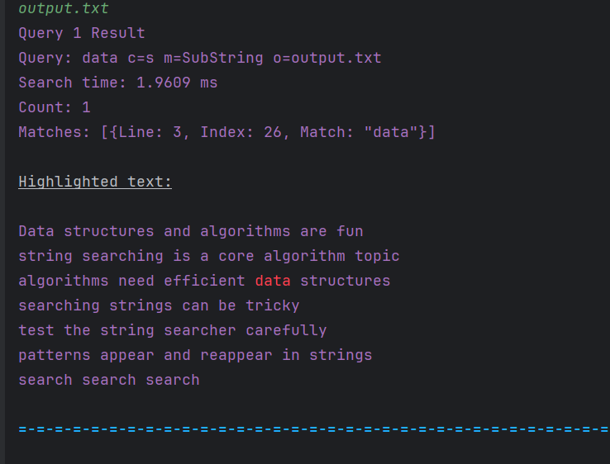
How to Use console project
Console Project Output
Matches are highlighted in red on the screen
Output is also saved in the output file (output.txt in my case)
If an invalid output path is entered, the program defaults to output.txt

Slide 13
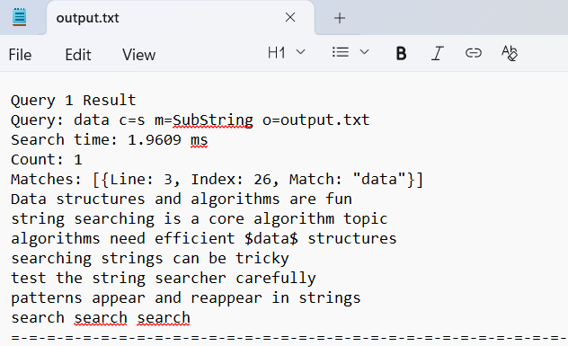
How to Use console project
Console Project Output in output.txt (see image)

Slide 14
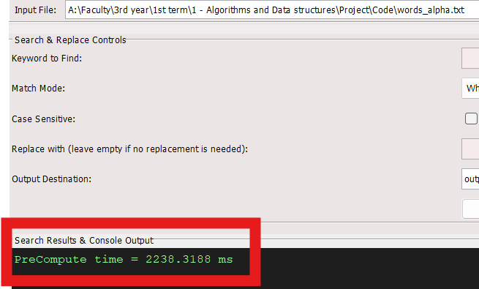
Performance test
Use words_alpha.txt from the repo (contains 370K+ words)
Precompute time: ~2 seconds (see image)
Each query takes only a few milliseconds

Slide 15
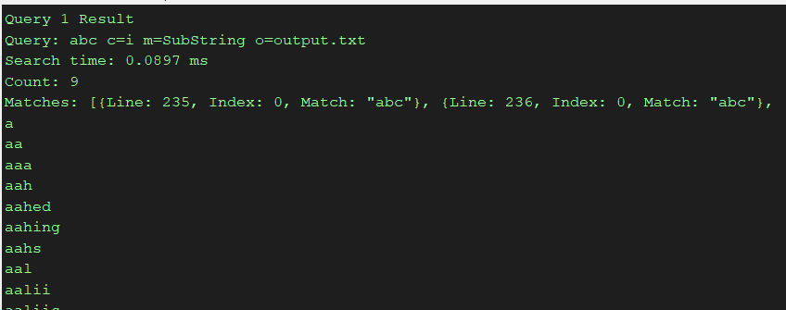
Performance test
Example Query

Slide 16
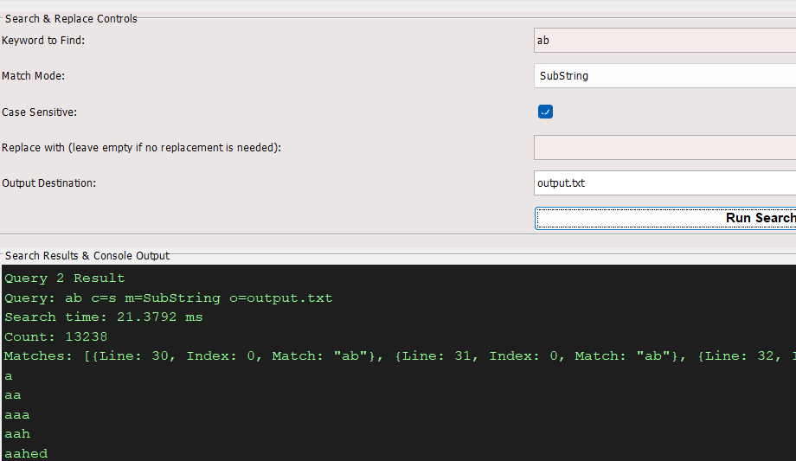
Performance test
Example Query

Slide 17


